Slide 1
Narrative Nexus
The Dynamic Text Analysis Platform

Slide 2
TABLE OF CONTENTS
1.Project Overview
2.Dataset Overview
3.Text Preprocessing
4.Topic Modelling
5.Perplexity and Coherence
6.Summarization
7.Word Cloud
8.User Interface
9.Challenges
10.Conclusion

Slide 3
Project overview
Objective :
To build a model that analyzes the sentiment of the given text whether it is a positive , negative or neutral statement and also other analysis like summarization,keywords extraction etc. This text analysis is very essential for real world applications like Market Research ,Social Media Monitoring , Product Development etc.
Outcomes:
A trained model that detects the sentiment of the given text and also shows other analysis on which the model has trained.

Slide 4
Dataset Overview
Structure • 9 columns – Review_ID, Text, Summary, Score, Product, Category, Sentiment, Votes, Date
Size • 15,000 Amazon food reviews
Strengths • Rich, diverse, and sentiment-balanced dataset
REASON FOR CHOOSING THE DATASET
Controlled Data Quality • Clean and consistent reviews that reduce preprocessing complexity
Wide Product & Category Coverage • Covers 8 food categories and multiple products for better generalization
Designed for NLP Performance • Supports sentiment analysis, topic modeling, and text summarization

Slide 5
Text Preprocessing
Cleaning & Normalization
Converted all text to lowercase
Removed URLs, numbers, and special characters
Removed extra whitespace
Tokenization & Filtering
Tokenized text into individual words
Removed stopwords, including custom domain-specific terms
Filtered out short and meaningless words
Lemmatization
Converted words to their base form for consistency
Feature Extraction
Added Word Count and Character Count
Computed vocabulary size for dataset insights

Slide 6
TOPIC MODELING (LDA)
• Used Gensim LDA to extract hidden themes from 15,000 cleaned reviews • Tokenized documents and created a filtered dictionary (removed rare/common words) • Built Bag-of-Words corpus for efficient topic learning • Trained LDA model with 8 topics, auto-tuned alpha and eta for better coherence • Identified top keywords for each topic to understand review themes • Saved trained LDA model for further analysis and visualization

Slide 7
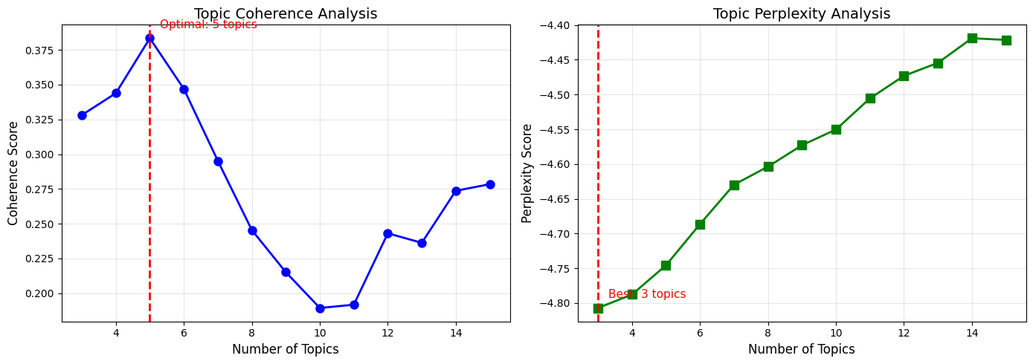
TOPIC OPTIMIZATION USING COHERENCE & PERPLEXITY
• Evaluated topic counts from 3 to 15
• Coherence Score used to measure topic clarity
• Perplexity used to assess model fit
• Optimal topic count identified using highest coherence
• Final LDA model trained with the best topic number
Coherence highlights 5 topics as the most meaningful, and Perplexity trends support reliable model performance across topic sizes.

Slide 8
Summarization
EXTRACTIVE SUMMARIZATION – MODEL TRAINING
• LSA Summarizer: Uses TF-IDF + SVD to extract topic-important sentences • TextRank Summarizer: Graph-based ranking using sentence similarity • Hybrid Model: Combines LSA & TextRank for best-quality summaries • Outcome: All models trained and saved for generating concise summaries

Slide 9
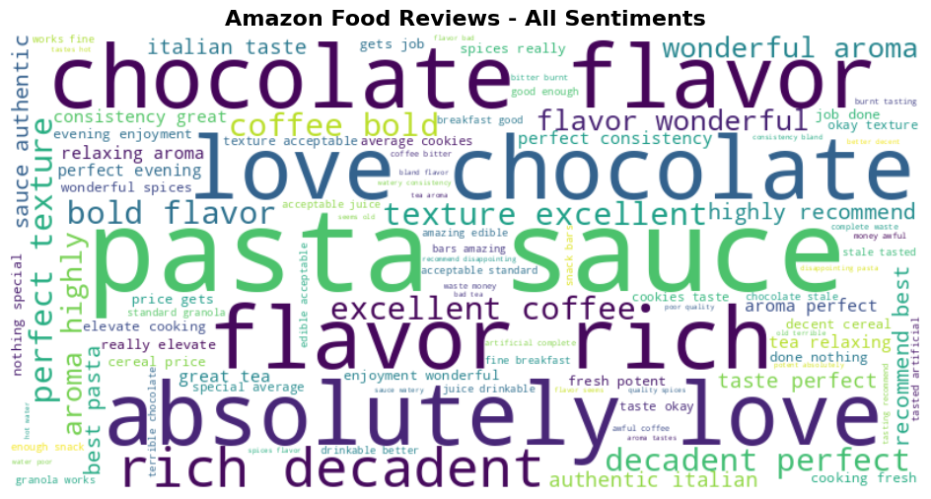
Word Cloud Visualization
• Generated word clouds for overall and sentiment-wise reviews
• Removed stopwords to highlight meaningful keywords
• Identified dominant terms to reveal key themes.
Frequently occurring keywords highlight dominant product themes and overall customer sentiment.

Slide 10
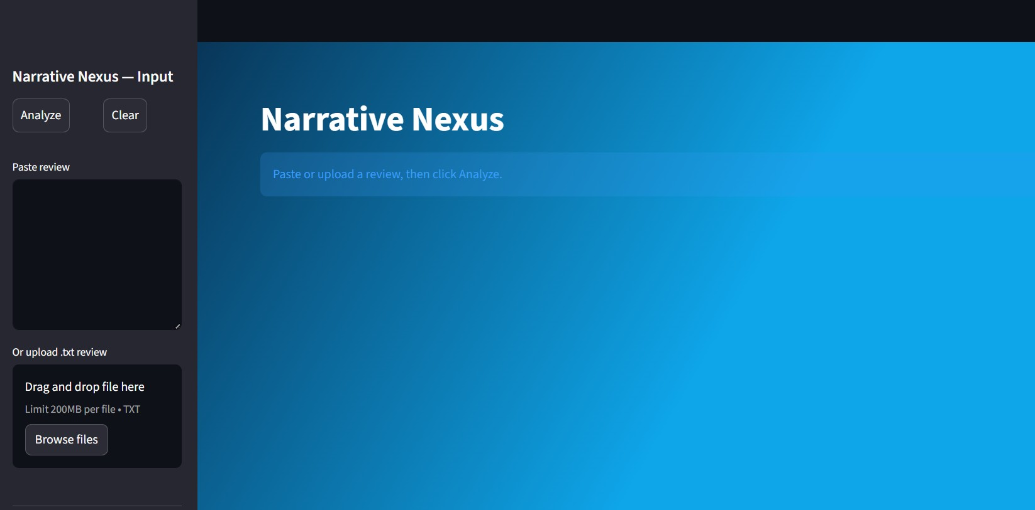
User Interface Overview

Slide 11
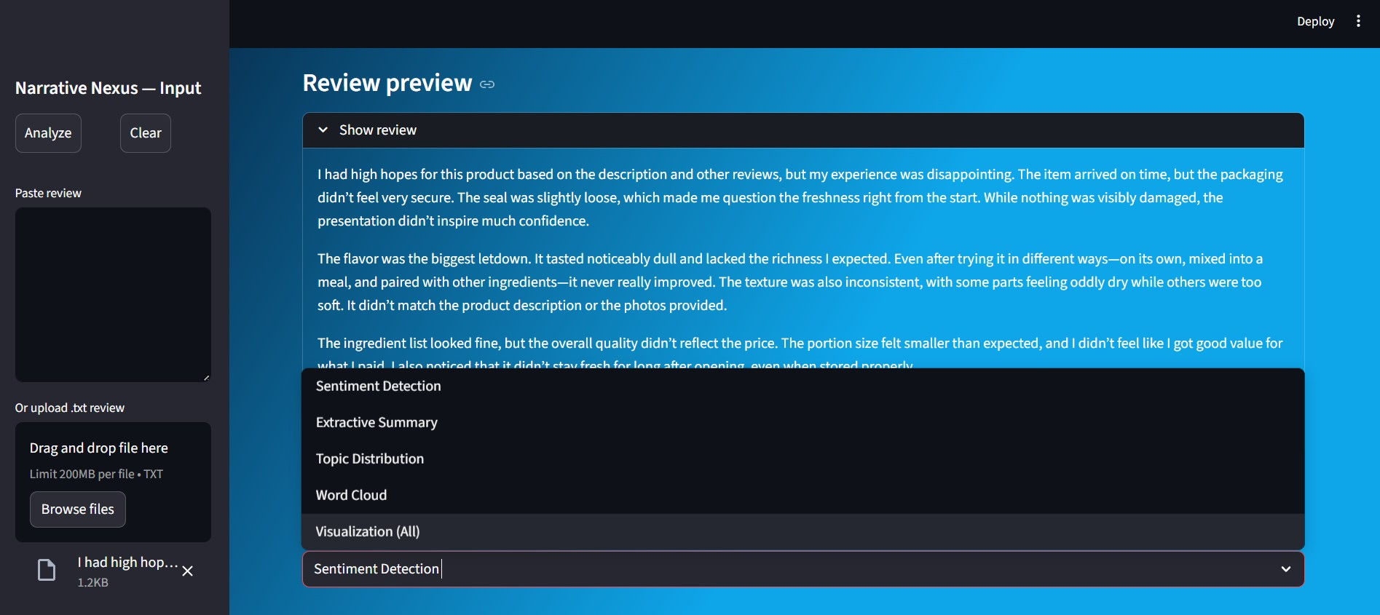
User Interface Features
Interactive interface enabling flexible text input and multi-feature NLP analysis.

Slide 12
Challenges
Handling Imbalanced Sentiment Data: • The dataset contained more neutral and positive reviews than negative ones • This affected the model’s ability to learn under-represented sentiment classes
Overlapping Sentiment Expressions: • Some reviews contained both positive and negative phrases, causing ambiguity • Identifying the dominant sentiment required careful tuning and evaluation
Integrating Multiple Models in Streamlit: • Managing TF-IDF, sentiment classifier, label encoder, and LDA models without version conflicts was challenging • Handling session state, widget resets, and runtime stability required careful design

Slide 13
Conclusion
The Narrative Nexus system successfully analyzes customer reviews using sentiment detection, topic modeling, keyword extraction, and visualization.
The project demonstrates how NLP and machine learning can transform raw text into meaningful insights that support decision-making.
By integrating multiple models into a user-friendly Streamlit application, the solution provides fast, interpretable, and visually appealing feedback for any Amazon food review.
Overall, the project provides a reliable and easy-to-use tool for understanding customer feedback and supporting better decision-making.

Slide 14

THANK YOU
Name: Manisha Gurugubelli
Batch: 03

